Slide 1
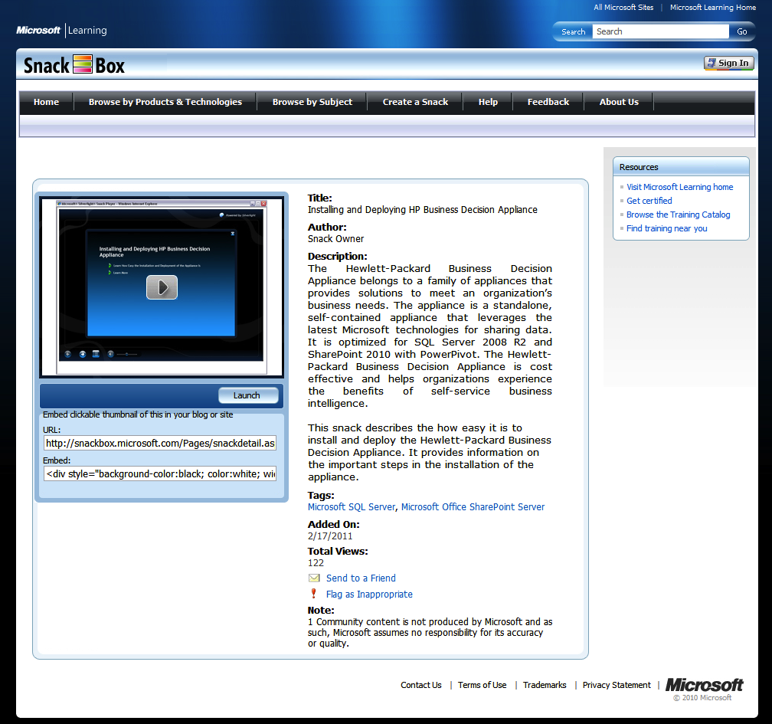
Microsoft Snackbox Silverlight Design
The Challenge
Microsoft needed to re-brand and re-launch their SnackBox site using a new, brand-compliant style. Several performance issues necessitated a re-engineering of the site’s back end.
What We Did
Affirma leveraged SharePoint 2007 and Podcasting Kit to make the site consistent with brand style-guidelines and enhance consistency and efficiency of video processing.
Results
Affirma fully updated the Silverlight Learning Snack, allowing users to easily update interactive learning presentations about Microsoft technologies as needed. We created a positive impact on the growing and vibrant community by making the process of sharing Learning Snacks more efficient, streamlined and intuitive.

